Slide 1
Catalog:
1. Part analysis
2. Runner analysis
3. Runner Injection condition
4. Fill time
5. Fill time (animation)
6. Flow front temperature
7. Temperature(animation)
8. Filling end pressure
9. Pressure(animation)
10. Injection location pressure: XY figure
11. Clamp force: XY figure
12. Weld line
13. Air traps
14. Shrinkage estimation
15. X Component deflection
16. Y Component deflection
17. Z Component deflection
Job for: 100112.19-13_Halter
Date：2018.07.28

Slide 2
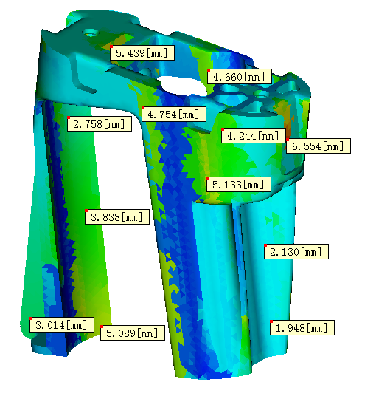
Product structure analysis
* Part name : EG20181166
- Gate thickness: 3.0（mm）
- Average wall thickness : 2.5（mm）
* Part information:
- Weight: 33.34g
- Cavity no. : 1
- Spec.: 86*81*30（mm）
* Material info.：Delrin 100 NC010
- Manufacturer: DuPont Performance Polymers
- Brand: POM
- MFR: 2g/10min; Load: 2.16kg
- Material temp. : 210~220°C
- Mold temp.: 80~100°C
- Material melt temp.: 203°C
- Ejection temp.: 123°C

Slide 3
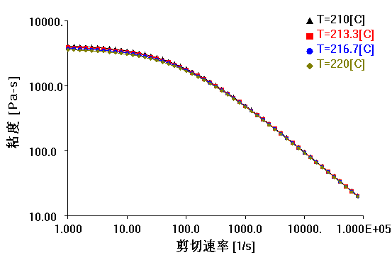
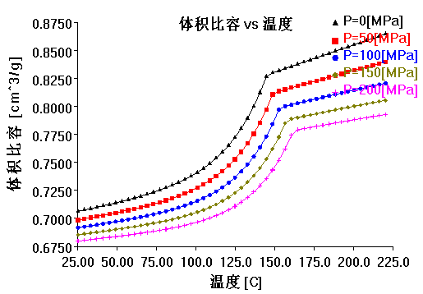
Material introduction
Viscosity: The higher the viscosity, the greater the flow resistance and the difficulty of the flow. For the general thermoplastic, the viscosity is a function of the plastic composition, temperature, pressure and shear rate. As to the temperature effect, the viscosity of the thermoplastic is generally reduced with the temperature.
PVT (PVT Relationship): The specific volume or density of plastic is a function of phase state, temperature, pressure, etc. in general, it can be quantified by the state equation (state equation) or PVT equation. One but the model parameters are obtained by experiment, and the specific volume or density value of the plastic at a certain temperature pressure can be obtained.

Slide 4
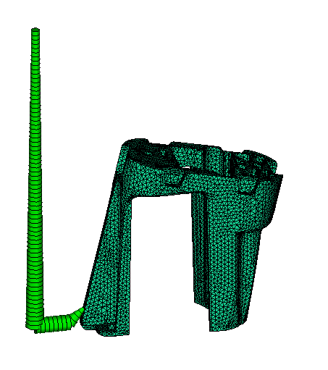
Runner system
Main runner Ø3.5
Gate Ø.1.5
Runner Ø6

Slide 5
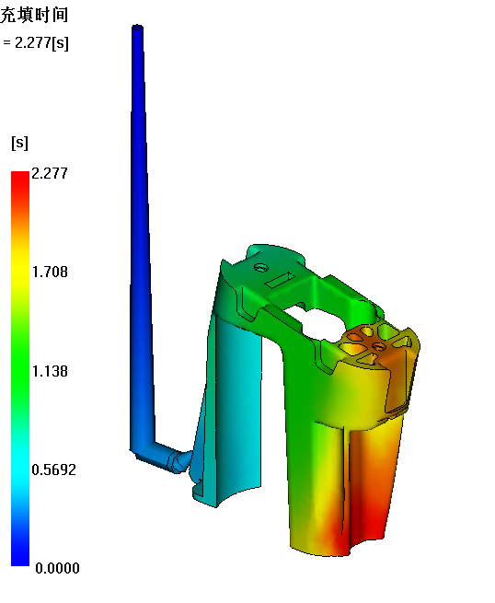
Fill Pattern
It is finish fill by 2.277s. The simulation results show that the current gate condition can meet the molding requirements.

Slide 6
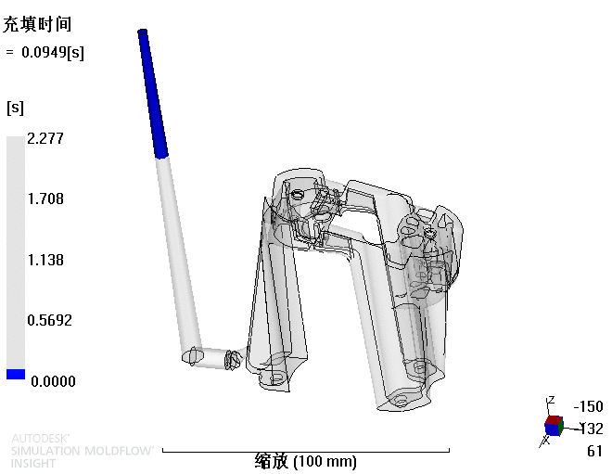
Part fill (animation)
Play
Shift+F5

Slide 7
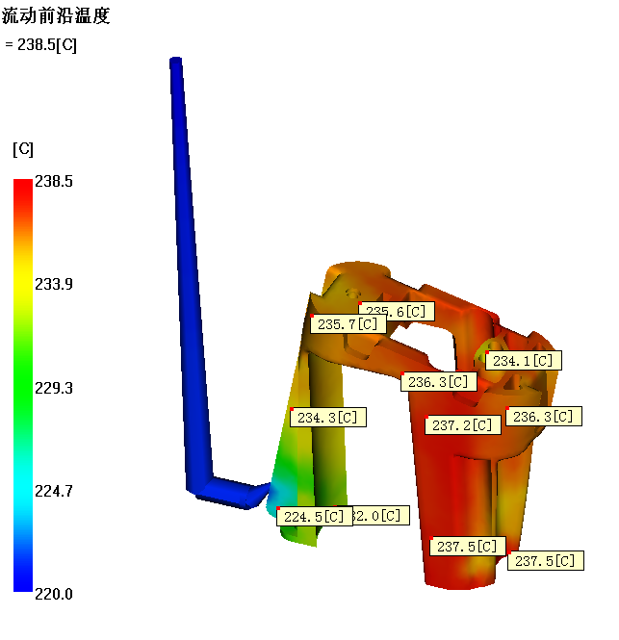
Flow front temperature
The flow front temperature distribution is based on the color distribution of the product and its corresponding value. The temperature is on the low side.

Slide 8
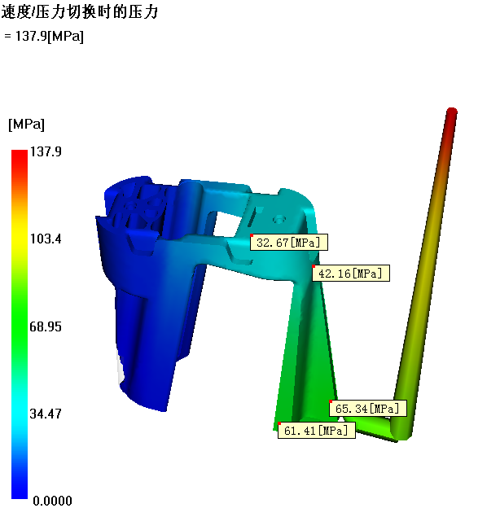
Pressure at V/P switchover
The material flowing is bad when the pressure is 137.9MPA.

Slide 9
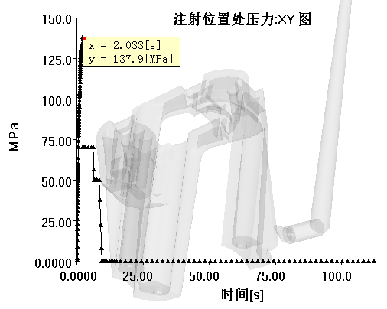
Pressure
Max. pressure is 137.9MPA

Slide 10
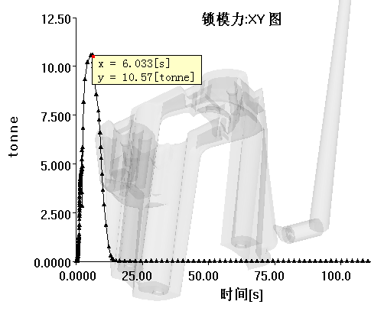
Clamp Force
Max clamp force is 10.57T.

Slide 11
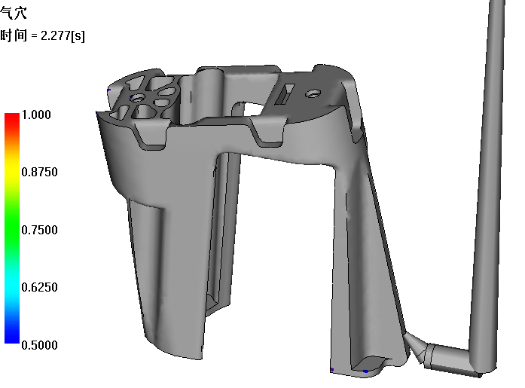
Air traps

Slide 12
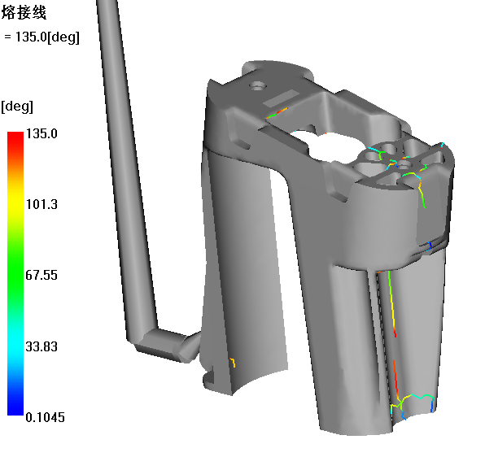
Weld lines
Weld lines are shown as picture.

Slide 13
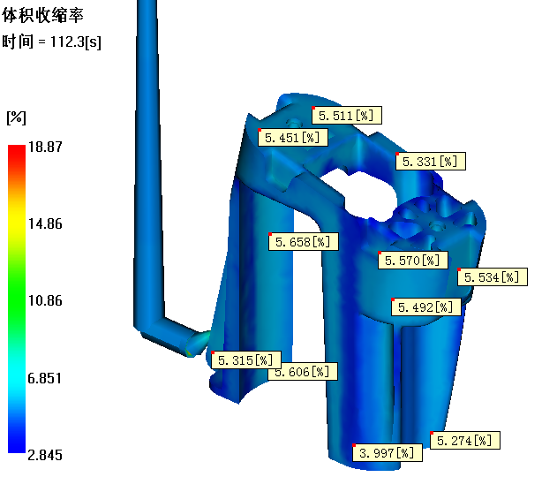
Volumetric Shrinkage

Slide 14
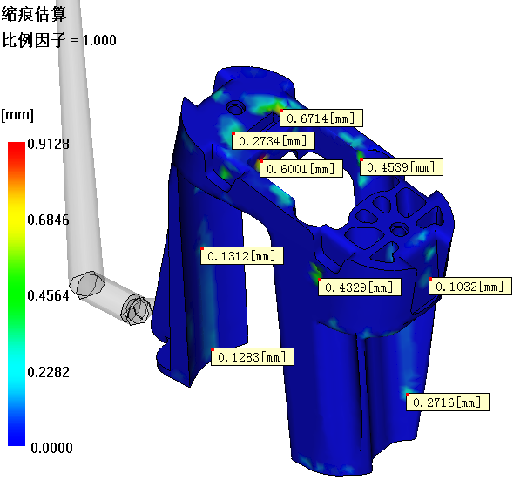
Sink marks, index
There is visible shrinkage when it is over 0.025mm.

Slide 15
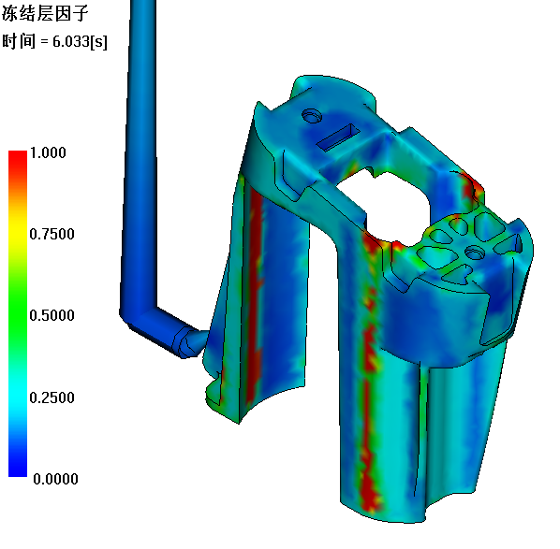
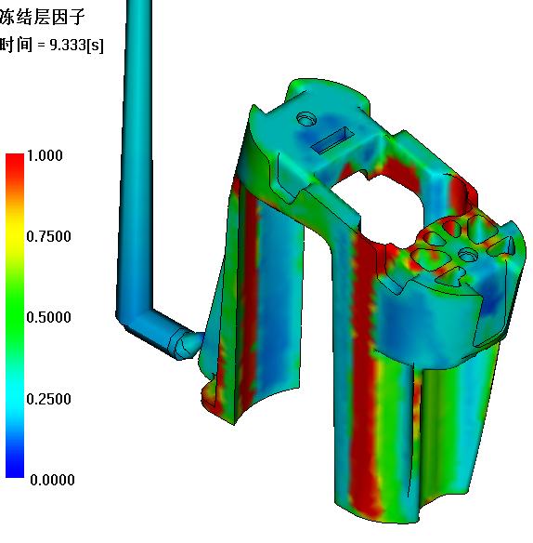
Frozen layer fraction
As shown in the figure 6.03s:
The excessive cold here may affect the product's holding pressure.

Slide 16
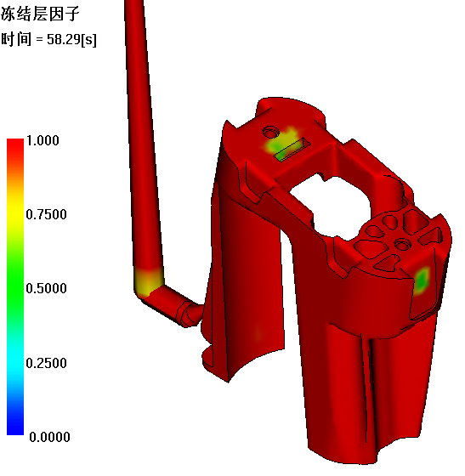
Frozen layer fraction
As shown in the figure 58.29ss:
It is complete frozen in red, the circle area will be frozen at last.

Slide 17
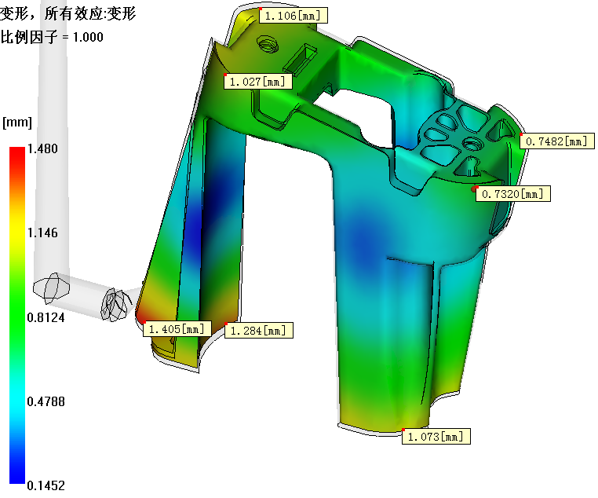
Deflection, all effects: Deflection (Scale=1)

Slide 18
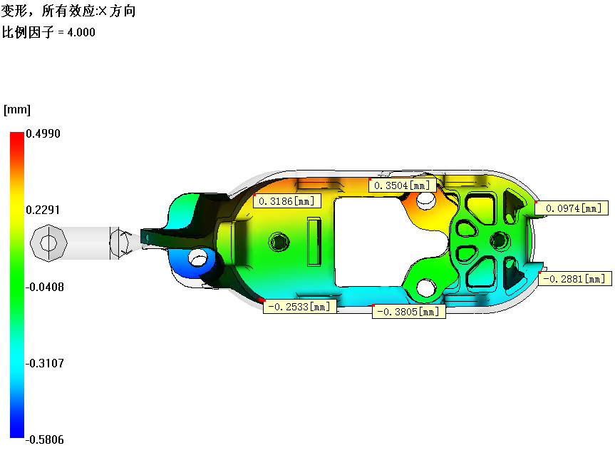
Deflection, all effects: X Component (Scale=4)

Slide 19
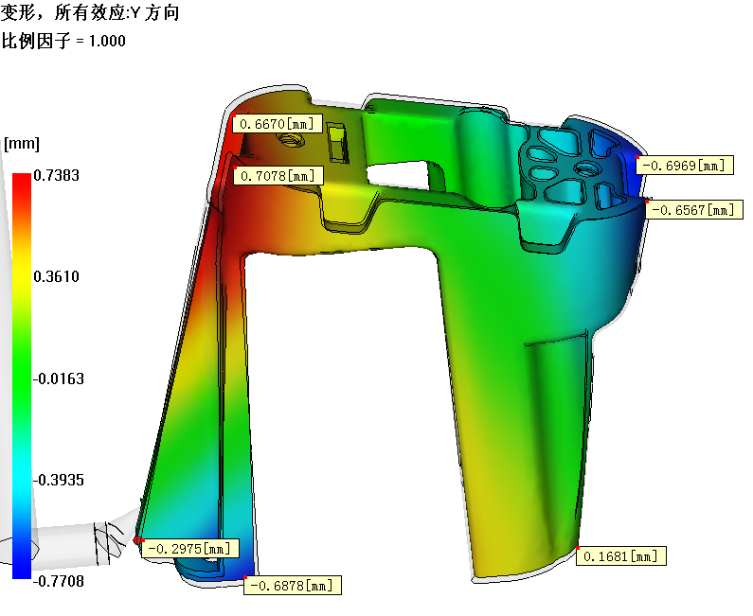
Deflection, all effects: Y Component (Scale=1)

Slide 20
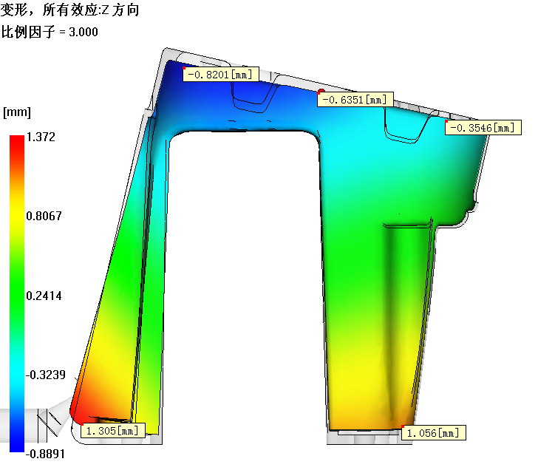
Deflection, all effects: Z Component (Scale=3)

Slide 21
Summarize:
The fill pattern is ok.
Take care for venting design.
Weld line will be effect visible surface.(see page 12)
The needed max. pressure ：137.9MPA，the needed max. clamp force： 10.57T.
Deflection for reference.

