Slide 1
模具表面处理种类及规格

Slide 2
抛光（Polish)
火花纹(Thin Fire Texture)
化学蚀纹（Texture)
蚀纹处理和模具斜度
电镀(Plating)
喷砂（Blasting）

Slide 3
抛光（Polish)

Slide 4
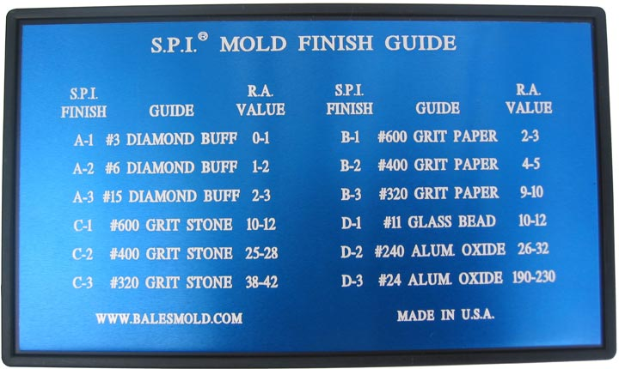
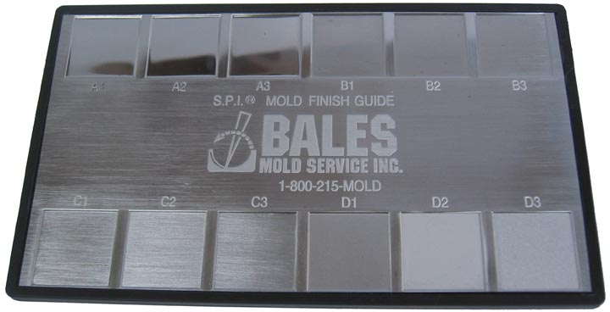
SPI - Society of the Plastics Industry
塑料工业协会

Slide 5
Diamond Mold Polishing & Finishing Specifications
Types of Finishes | Current SPI Finish Numbers |  | Description and Previous Finish Numbers |  | Roughness Comparison R.A.
Diamond | #1 Diamond Buff （#1钻石膏，光学要求） | A0
 | #3 Diamond Buff （#3钻石膏，镜面） | A1 | is comparable to | #1 | 0-1
 | #6 Diamond Buff （#6钻石膏，镜面） | A2 | is slightly finer than | #2 | 1-2
 | #15 Diamond Buff （#15钻石膏，镜面） | A3 | has more imperfections than |  | 2-3
Paper | 600 Grit （600砂纸，光面） | B1 | is finer than | #3 | 2-3
 | 400 Grit （400砂纸，光面） | B2 | is slightly finer than |  | 4-5
 | 320 Grit （320砂纸，光面） | B3 | is comparable to |  | 9-10
Stone | 600 Stone （600油石，光面） | C1 | is finer than | #4 | 10-12
 | 400 Stone （400砂纸，光面） | C2 | is slightly finer than |  | 25-28
 | 320 Stone （320砂纸，哑面） | C3 | is comparable to |  | 38-42
Dry Blasted | #11 Glass Bead （#11粗玻璃砂） | D1 | is finer than | #5 | 10-12
 | #240 Aluminum Oxide Blast （#240氧化铝） | D2 | is comparable to |  | 26-32
 | #24 Aluminum Oxide Blast （#24氧化铝） | D3 | is a little more coarse than |  | 190-230

Slide 6
钻石抛光
（非常适合镀镍和镀铬）
SPIA-1
（高质量外观或者镜片模具）
SPIA-2
（良好脱模和外观）
砂纸抛光
（轻微高光面，良好脱模，用在装饰要求不高的场合）
SPIB-1
SPIB-2
油石抛光
（非高光面，良好脱模，也是砂纸和钻石抛光的头道工序）
SPIC-1
SPIC-2
喷砂抛光
（网点和纹理表面）
SPID-1
SPID-2
SPIA-3
（良好脱模，外观无需高光）
SPIB-3
SPIC-3
SPID-3

Slide 7
火花纹(Thin Fire Texture)

Slide 8
CHARMILL VDI Specification
号码 | 电火花深度（mm) |  | 号码 | 电火花深度（mm)
0 | 0.00040 |  | 21 | 0.00448
1 | 0.00044 |  | 22 | 0.00504
2 | 0.00048 |  | 23 | 0.00560
3 | 0.00056 |  | 24 | 0.00648
4 | 0.00064 |  | 25 | 0.00720
5 | 0.00072 |  | 26 | 0.00800
6 | 0.00080 |  | 27 | 0.00880
7 | 0.00088 |  | 28 | 0.01000
8 | 0.00100 |  | 29 | 0.01120
9 | 0.00112 |  | 30 | 0.01280
10 | 0.00128 |  | 31 | 0.01400
11 | 0.00140 |  | 32 | 0.01600
12 | 0.00160 |  | 33 | 0.01800
13 | 0.00180 |  | 34 | 0.02000
14 | 0.00200 |  | 35 | 0.02240
15 | 0.00224 |  | 36 | 0.02520
16 | 0.00252 |  | 37 | 0.02800
17 | 0.00280 |  | 38 | 0.03200
18 | 0.00320 |  | 39 | 0.03600
19 | 0.00360 |  | 40 | 0.04000
20 | 0.00400 |  | 41 | 0.04480

Slide 9
火花纹规格和图纸表面粗糙度要求对照表
符号 | 粗糙度 |  | 符号 | 粗糙度
AGIE 1 | Ra 0.2 |  | VDI12 | Ra 0.40
AGIE 2 | Ra 0.315 |  | VDI15 | Ra 0.50
AGIE 3 | Ra 0.5 |  | VDI18 | Ra 0.80
AGIE 4 | Ra 0.8 |  | VDI21 | Ra 1.12
AGIE 5 | Ra 1.25 | Fine | VDI24 | Ra 1.60
AGIE 6 | Ra 2.00 | Fine | VDI27 | Ra 2.24
AGIE 7 | Ra 3.15 | Medel | VDI30 | Ra 3.15
AGIE 8 | Ra 5.0 | Grov | VDI33 | Ra 4.50
AGIE 9 | Ra 8.0 |  | VDI36 | Ra 6.30
AGIE 10 | Ra 12.5 |  | VDI39 | Ra 9.00
 |  |  | VDI42 | Ra 12.5
 |  |  | VDI45 | Ra 18.0
Ra -在取样长度内，轮廓偏距绝对值的算术平均值，单位: μ 。

Slide 10
化学蚀纹（Texture)

Slide 11
MT Specification
单位：mm
号码 | 咬花深度
MT-11000 | 0.0102
MT-11010 | 0.0254
MT-11020 | 0.0381
MT-11030 | 0.0508
MT-11040 | 0.0762
MT-11050 | 0.1143
MT-11060 | 0.0762
MT-11070 | 0.0762
MT-11080 | 0.0508
MT-11090 | 0.0889
MT-11100 | 0.1524
MT-11110 | 0.0635
MT-11120 | 0.0508
MT-11130 | 0.0635
MT-11140 | 0.0635
MT-11150 | 0.0698
MT-11160 | 0.1016

Slide 12
蚀纹处理和模具斜度的关系
Mold-Tech A |  |  | Mold-Tech B
Ptn.# | Depth(mm) | Angle | Ptn.# | Depth(mm) | Angle
MT-11000 | 0.0004 | 1° | MT-11200 | 0.003 | 4.5°
MT-11010 | 0.001 | 1.5° | MT-11205 | 0.0025 | 4°
MT-11020 | 0.0015 | 2.5° | MT-11210 | 0.0035 | 5.5°
MT-11030 | 0.002 | 3° | MT-11215 | 0.0045 | 6.5°
MT-11040 | 0.003 | 4.5° | MT-11220 | 0.005 | 7.5°
MT-11050 | 0.0045 | 6.5° | MT-11225 | 0.0045 | 6.5°
MT-11060 | 0.003 | 4.5° | MT-11230 | 0.0025 | 4°
MT-11070 | 0.003 | 4.5° | MT-11235 | 0.004 | 6°
MT-11080 | 0.002 | 3° | MT-11240 | 0.0015 | 2.5°
MT-11090 | 0.0035 | 5.5° | MT-11245 | 0.002 | 3°
MT-11100 | 0.006 | 9° | MT-11250 | 0.0025 | 4°
MT-11110 | 0.0025 | 4° | MT-11255 | 0.002 | 3°
MT-11120 | 0.002 | 3° | MT-11260 | 0.004 | 6°
MT-11130 | 0.0025 | 4° | MT-11265 | 0.005 | 7°
MT-11140 | 0.0025 | 4° | MT-11270 | 0.004 | 6°
MT-11150 | 0.00275 | 4° | MT-11275 | 0.0035 | 5°
MT-11160 | 0.004 | 6° | MT-11280 | 0.0055 | 8°

Slide 13
蚀纹处理和模具斜度的关系
Mold-Tech C |  |  | Mold-Tech D
Ptn.# | Depth | Angle | Ptn.# | Depth | Angle
MT-11300 | 0.0025 | 3.5° | MT-11400 | 0.002 | 3°
MT-11305 | 0.005 | 7.5° | MT-11405 | 0.0025 | 4°
MT-11310 | 0.005 | 7.5° | MT-11410 | 0.0035 | 5.5°
MT-11315 | 0.001 | 1.5° | MT-11415 | 0.002 | 3°
MT-11320 | 0.0025 | 4° | MT-11420 | 0.0025 | 4°
MT-11325 | 0.003 | 4.5° | MT-11425 | 0.0035 | 5.5°
MT-11330 | 0.002 | 3° | MT-11430 | 0.007 | 10°
MT-11335 | 0.002 | 3° | MT-11435 | 0.010 | 15°
MT-11340 | 0.003 | 4.5° | MT-11440 | 0.0005 | 1.5°
MT-11345 | 0.003 | 4.5° | MT-11445 | 0.0015 | 2.5°
MT-11350 | 0.0035 | 5.5° | MT-11450 | 0.0025 | 4°
MT-11355 | 0.0025 | 4° | MT-11455 | 0.003 | 4.5°
MT-11360 | 0.0035 | 5.5° | MT-11460 | 0.0035 | 5.5°
MT-11365 | 0.0045 | 7° | MT-11465 | 0.005 | 7.5°
MT-11370 | 0.004 | 6° | MT-11470 | 0.002 | 3°
MT-11375 | 0.004 | 6° | MT-11475 | 0.002 | 3°
MT-11380 | 0.004 | 6° | MT-11480 | 0.003 | 4.5°

Slide 14
Plaque #6 |  | Plaque #7 |  | Plaque #8 |  | Plaque #10
Ptn.# | Depth(mm) | Ptn.# | Depth(mm) | Ptn.# | Depth(mm) | Ptn.# | Depth(mm)
MT229 | 0.003 | MT325 | 0.003 | MT588 | 0.0085 | MT980 | 0.004
MT392 | 0.004 | MT964 | 0.003 | MT888 | 0.013 | MT901 | 0.003
MT585 | 0.0035 | MT1038 | 0.002 | MT1028 | 0.0035 | MT945 | 0.0065
MT889 | 0.004 | MT1043 | 0.002 | MT1067 | 0.013 | MT970 | 0.002
MT1013 | 0.003 | MT1170 | 0.0025 | MT1149 | 0.013 | MT972 | 0.0025
MT1015 | 0.0055 | MT1192 | 0.0015 | MT1153 | 0.0075 | MT973 | 0.0035
MT1039 | 0.003 | MT1239 | 0.003 | MT1211 | 0.0095 | MT974 | 0.0025
MT1055 | 0.0055 | MT1240 | 0.003 | MT1226 | 0.0035 | MT978 | 0.003
MT1068 | 0.0055 | MT1241 | 0.002 | MT1227 | 0.0035 | MT985 | 0.0025
MT1070 | 0.007 | MT1242 | 0.002 | MT1228 | 0.0095 | MT1055-1 | 0.0001
MT1074 | 0.0055 | MT1243 | 0.002 | MT1230 | 0.013 | MT1055-2 | 0.0045
MT1129 | 0.003 | MT1244 | 0.0025 | MT1232 | 0.003 | MT1055-3 | 0.0005
MT1159 | 0.008 | MT1250 | 0.003 | MT1233 | 0.0035 | MT1055-4 | 0.0075
MT1122 | 0.0015 | MT2019 | 0.0025 | MT1234 | 0.0035 | MT1055-5 | 0.001
MT1125 | 0.006 | MT2020 | 0.002 | MT1235 | 0.0035 | MT1055 | 0.0015
MT1126 | 0.0065 | MT2028 | 0.0025 | MT1236 | 0.0035 | MT1055-6 | 0.0017
MT1127 | 0.0025 | 23053 | 0.002 | MT1238 | 0.0045 | MT1055-7 | 0.0225
MT1526 | 0.0135 | 23064 | 0.0015 | 23031 | 0.0085

Slide 15
昵宏咬花規格表

Slide 16
咬花番號 | 拔模斜度 | 平均值 μ | 打光程度 | 加工種類
HN-DS11 | 1° | 5 ~ 7 | 800 | 噴砂咬花
HN-DS12 | 1.5° | 10 ~ 13 | 600 ~ 800
HN-DS13 | 2° | 12 ~ 15 | 600 ~ 800
HN-DS14 | 2° | 13 ~ 19 | 600 ~ 800
HN-DS01 | 3° | 25 ~ 30 | 320
HN-DS02 | 4° | 35 ~ 40 | 320
HN-DS03 | 4° | 36 ~ 42 | 320 | 化學咬花
HN-DS04 | 4.5° | 38 ~ 43 | 320
HN-DS05 | 1.5° | 9 ~ 13 | 800
HN-DS06 | 2° | 14 ~ 19 | 800
HN-DS07 | 2.5° | 19 ~ 24 | 600
HN-DS08 | 3° | 25 ~ 30 | 400

Slide 17
咬花番号 | 拔模斜度 | 平均值μ | 打光程度 | 加工种类
梨地NO. 1 | 2° | 8~9 | #400
梨地NO. 2 | 2.5° | 15~16 | #400
梨地NO. 3 | 3° | 15~17 | #400
梨地NO. 4 | 3.5° | 16~18 | #400
梨地NO. 5 | 4° | 20~23 | #400
梨地NO. 6 | 4.5° | 25~30 | #400
梨地NO. 7 | 6° | 40~42 | #320
梨地NO. 8 | 6° | 57~60 | #320
梨地NO. 9 | 6° | 60~66 | #320
S ---半光泽 G ---半光泽

Slide 18
咬花番號 | 拔模斜度 | 平均值 μ | 打光程度 | 加工種類
NO. 1 | 1° | 1.7 | 鏡面
NO. 2 | 1° | 1 | 鏡面
NO. 3 | 1° | 1.4 | 鏡面
NO. 4 | 1° | 1.8 | 1000
NO. 5 | 1° | 2.9 | 1000
NO. 6 | 1.5° | 4 | 1000
NO. 7 | 1.5° | 6.5 | #800
NO. 8 | 2° | 7 | #800
NO. 9 | 2.5° | 7.7 | #800
NO. 10 | 3° | 10~11 | #600
NO. 11 | 3~4° | 12~15 | #600
NO. 12 | 4~5° | 16~18 | #600
S ---半光澤 G ---半光澤

Slide 19
咬花番號 | 拔模斜度 | 平均值 μ | 打光程度 | 加工種類
HN20 | 2.5° | 12~14 | #400 | 喷砂
HN21 | 3° | 15~17 | #400
HN22 | 3~4° | 23~25 | #400
HN23 | 4~5° | 33~37 | #320
HN24 | 4° | 19~21 | #320 | 梨地
HN25 | 4° | 23~25 | #320
HN26 | 4° | 26~30 | #320
HN27 | 5° | 37~40 | #320
HN28 | 5~6° | 41~43 | #320
HN29 | 5~6° | 45~50 | #320
HN30 | 6° | 58~63 | #320
HN31 | 6° | 65~73 | #320
S ---半光澤 G ---半光澤

Slide 20
喷砂流程
模具脱脂
封贴
喷砂
除去贴纸
清洗
防锈
梨地流程
模具脱脂
封贴
表面处理
蚀刻
喷砂用封贴
干燥
喷砂
除去贴纸
清洗
防锈

Slide 21
咬花番号 | 拔模斜度 | 平均值μ | 打光程度 | 加工种类
HN1000 | 1° | 4~5 | #800
HN1001 | 1° | 5~6 | #800
HN1002 | 1.5° | 8~ | #800
HN1003 | 1° | 3~4 | #800
HN1004 | 1° | 4~5 | #800
HN1005 | 1° | 5~6 | #800
HN1006 | 2° | 10~11 | #600
HN1007 | 2.5° | 12~13 | #600
HN1008 | 3° | 17~19 | #600
HN1009 | 1.5° | 6~7 | #600
HN1010 | 2° | 7~8 | #600
HN1011 | 3° | 13~14 | #600
HN1012 | 3.5° | 25~27 | #400
HN1013 | 4° | 33~37 | #400
HN1014 | 5° | 43~50 | #400
HN1015 | 3° | 19~21 | #400
HN1016 | 4° | 32~~33 | #320
HN1017 | 5° | 36~~38 | #320
S ---半光泽 G ---半光泽

Slide 22
咬花番号 | 拔模斜度 | 平均值μ | 打光程度 | 加工种类
HN2000 | 1.5° | 8~9 | #600
HN2001 | 2° | 13~15 | #600
HN2002 | 2.5° | 22~34 | #400
HN2003 | 3.5° | 40~44 | #400
HN2004 | 4° | 44~47 | #400
HN2005 | 5.5° | 61~65 | #400
HN2006 | 5.5° | 60~63 | #400
HN2007 | 5° | 61~64 | #400
HN2008 | 5° | 63~66 | #400
HN2009 | 3° | 33~35 | #400
HN2010 | 3.5° | 43~46 | #400
HN2011 | 2° | 20~21 | #400
HN2012 | 3° | 28~32 | #400
HN2013 | 3.5° | 30~35 | #400
HN2014 | 2.5° | 19~22 | #400
HN2015 | 2.5° | 25~29 | #400
HN2016 | 3° | 33~38 | #400
HN2017 | 4° | 38~41 | #400
HN2018 | 4° | 50~58 | #400
HN2019 | 5° | 70~75 | #400
HN2020 | 2° | 16~23 | #400
HN2021 | 2.5° | 23~26 | #400
HN2022 | 3° | 25~27 | #400
HN2023 | 4° | 30~34 | #400
HN2024 | 4.5° | 42~50 | #400
HN2025 | 5° | 52~56 | #400
HN2026 | 5° | 62~70 | #400

Slide 23
咬花番号 | 拔模斜度 | 平均值μ | 打光程度 | 加工种类
HN3000 | 1.5° | 4~5 | #800
HN3001 | 1.5° | 5~6 | #800
HN3002 | 1.5° | 7~9 | #800
HN3003 | 2.5° | 8~11 | #800
HN3004 | 3° | 10~15 | #600
HN3005 | 3° | 16~18 | #600
HN3006 | 3.5° | 17~20 | #600
HN3007 | 1.5° | 7~9 | #600
HN3008 | 2° | 9~11 | #600
HN3009 | 2.5° | 12~14 | #600
HN3010 | 2.5° | 15~18 | #600
HN3011 | 3° | 18~22 | #600
HN3012 | 3.5° | 24~28 | #600
HN3013 | 3.5° | 27~31 | #600
S ---半光泽 G ---半光泽

Slide 24
皮纹流程
模具脱脂
封贴
咬花加工面脱脂
描绘图形
烘烤
修正图形
二次封贴
蚀刻
喷砂用封贴
除去贴纸
清洗
防锈
图形流程
模具脱脂
咬花面脱脂
底片裁剪
感光膜涂布
干燥
贴底片
曝光
现象
加热
图形修正
封贴
蚀刻
感光膜剥离
喷砂
清洗
防锈

Slide 25
电镀(Plating)

Slide 26
非电镀镍
高级防氧化保护
中等耐磨
修正公差要求不高的位置（0.003”）

Slide 27
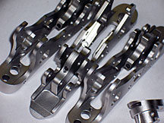
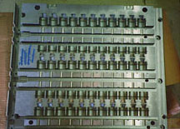
Hardness – HVN100 | As plated 450 / 50 RC Heat treated at: - 4hr, 350°F (177°C) 480 to 520 - 1hr, 750°F (400°C)
Phosphorus content, wt, %: | 10.5 to 12.0
Melting point: | 1620°F (880°C)
Corrosion related properties: | ASTM B-117 1.0 mil deposit, 1,000+ hours
Wear properties: | Taber abraser wear test Index value wt. loss mg/1,000 cycles As plated 5-18 Heat treated @ 1hr 750°F (400°C) 4-8
Thermal conductivity: | cal/cm/sec/C 0.0105

Slide 28
氨基磺酸镍电镀
复杂的尺寸修正（0.25mm沉积厚度）
耐摩擦和耐磨损
防腐蚀
作为电镀铬的基础层
摩擦系数 | 0.45 或更小
洛氏硬度 | 40 RC
电镀温度 | 140°F
理想用途 | 尺寸修正

Slide 29
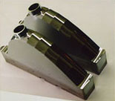
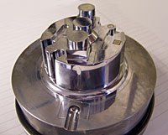
电镀硬铬
耐摩擦和耐磨损
硬度72RC
0.0003-0.0004厚度

Slide 30
喷砂（Blasting）

Slide 31
Wet Blasting (Liquid Honing)
The liquid honing or wet blasting process uses water to cushion the blast media and eliminates damage to the surface of the component, mold or tool. This process is used for precision surface finishing and allows us to control and regulate the flow and type of material used in the blasting slurry. It also allows us to control the velocity, pressure, location (areas can be masked) and other engineered elements to provide the optimum finish for your part, mold, die or tool.
Wet Blasting Process
Wet blasting is used primarily, but not exclusively, as a surface preparation. This process deep cleans with no damage, impregnation, dust, warping or contamination to the surface. It also provides superior bonding, extended duty and even abrasion to the surface.
Dry Blasting Process
A dry blasting cabinet system uses compressed air and an abrasive media feeder to mix particles and discharges this media, with the use of a nozzle, at the part surface. Media is recycled from the system to a hopper for reuse. This process is used for more aggressive surface preparation.
How Wet Blasting & Dry Blasting Are Used
Wet blasting and dry blasting are used for surface cleaning and preparation including creating a finish before plating; cleaning & stripping a surface for coating; establishing a stipple finish; gloss adjustment on texture finishes that have been acid engraved; de-burring; rust removal; de-scaling.

Slide 32
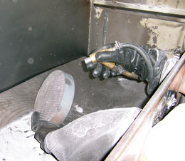
We use the following Blast Media:
Ceramic beads
Glass beads
Plastic
Aluminum oxide
Silicon carbide
Carborundum
Metal shot and steel grit
Glass bead and ceramic bead media are used to clean, smooth, brighten, peen, and de-scale surfaces. Fine glass and ceramic media can smooth or de-burr parts. Aluminum oxide, crushed glass, and steel grit are used in more aggressive applications such as machined components and can remove heavy scale or rust. Wet blasting can also aid in lubricity and release

